Slide 1
Dr. Holly Miller, Senior Advisor, STEM Next Opportunity Fund Patti Curtis, Senior STEM Advisor, Office of the Deputy Secretary U.S. Department of Education
Federal Opportunities to Support
STEM Education and the Role of
Out of School Time Learning
STEM Connector Innovation Forum
October 19, 2023

Slide 2
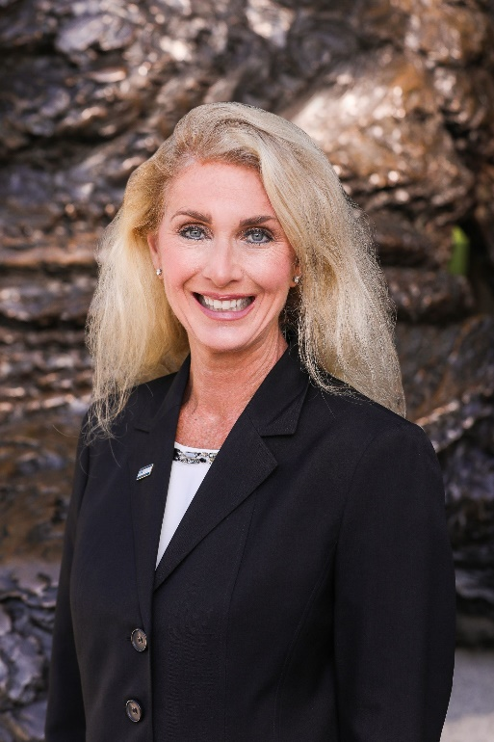
Holly Miller
Senior Advisor, STEM Next Opportunity Fund
Most recently, Afterschool and Summer Learning Fellow for the US Department of Education, Institute of Education Sciences
Previously an Albert Einstein Distinguished Educator Fellow in the US Senate
Former middle school STEM teacher
PhD in STEM Curriculum and Instruction

Slide 3
Who’s in the Room?

Slide 4
Overview
State of Education
STEM Funding Opportunities
ED Initiatives
You Belong in STEM
National STEM Festival
Raise the Bar
Engage Every Student
Action Items

Slide 5
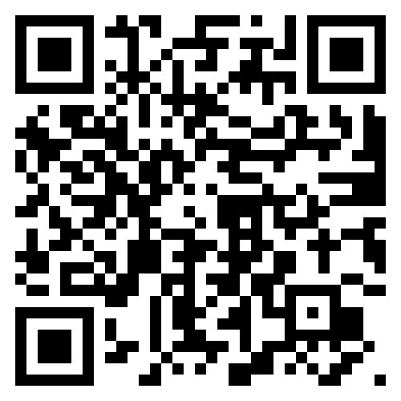
Report on the Condition of Education 2023

Slide 6
NAEP Long-Term Trend Assessment Results: Reading and Mathematics
9 yo

Slide 7
NAEP Long-Term Trend Assessment Results: Reading and Mathematics
13 yo

Slide 8
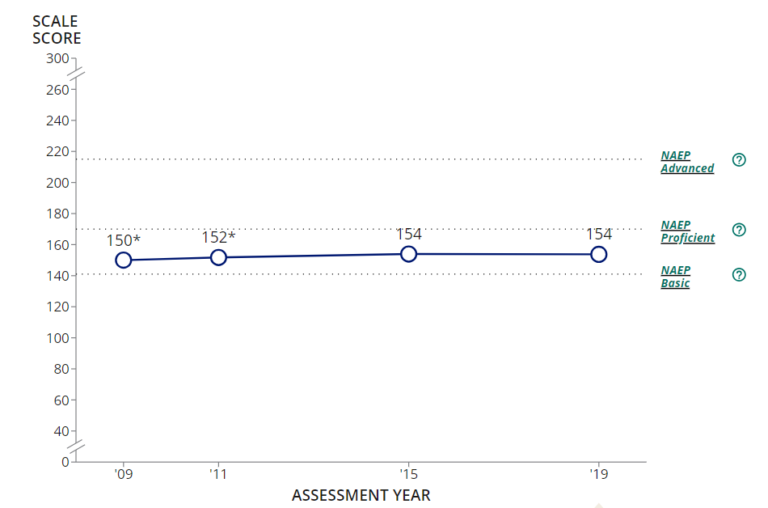
NAEP Science (8th grade)
Notes:
Add a graph here

Slide 9
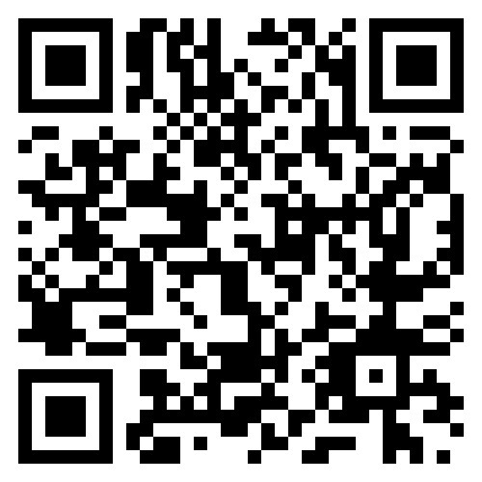
New Equity in Education Dashboard

Slide 10
STEM Funding Opportunities
Formula Programs
Discretionary Grant Programs
Emergency Funds

Slide 11
ED Grant Seekers?

Slide 12
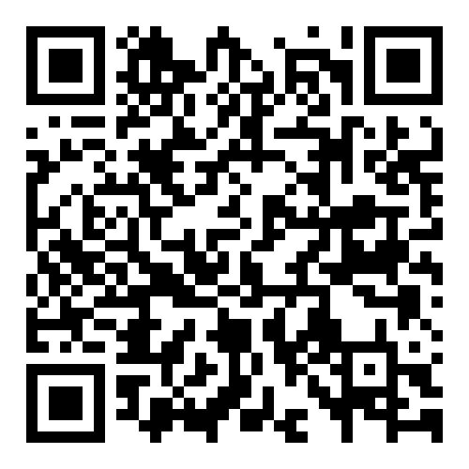
Formula Programs
STEM Dear Colleague Guidance
Title I Part A – Improving the Academic Achievement of the Disadvantaged
Title II Part A – Supporting Effective Instruction
Title IV Part A - Student Support & Academic Enrichment
STEM and Computer Science are explicitly mentioned under well-rounded
Title IV Part B – 21st Century Community Learning Centers

Slide 13
Discretionary Grant Programs
Education Innovation Research (EIR) Early Phase Grants
IES – STEM Education Research grants
Minority Science Engineering Improvement Program (MSEIP)
Upward Bound Math & Science
Teacher Quality Partnerships (TQP)
Supporting Effective Educator Development (SEED)
Augustus Hawkins Centers of Excellence

Slide 14
American Rescue Plan ($122B)
At least 1% of ARP ESSER funds are set aside for summer enrichment programs = $1.2B
At least 1% of ARP ESSER funds are set aside for afterschool programs = $1.2B
At least 5% of ARP ESSER funds are set aside to address learning loss = $6.1B (can include summer enrichment and afterschool)
At least 20% of local education agency (LEA) allocations must be used to address the impact of lost instructional time = $22B (can include summer enrichment and afterschool)
$1.2B + $1.2B + $6.1B + $22B = $30.5B

Slide 15
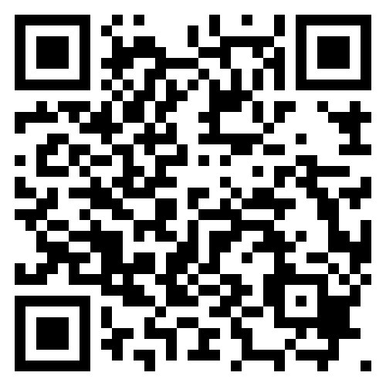
Education Stabilization Fund Tracker
Notes:
The Education Stabilization Fund (ESF) (aka ESSER funds or the American Rescue Plan) is a combined investment of over $263 billion into state and institutional COVID-19 recovery and rebuilding efforts, managed by the U.S. Department of Education.
This interactive tracker allows you to drill down into each subgrantee including school districts and OST providers.
For instance, this shows that CO received $2.8 B and has spent $2.1 B. And that several CO Boys & Girls Clubs are subgrantees.
WY on the other hand received $561 M and has only spent $337 M.
States have until Sept 2024 to obligate their funds before they expire.

Slide 16
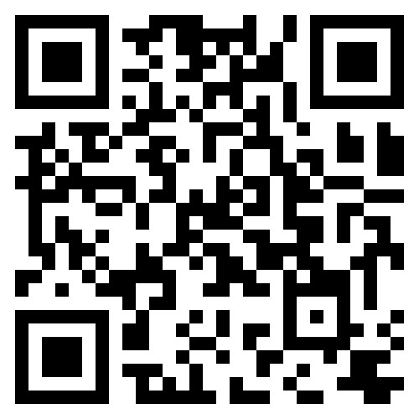
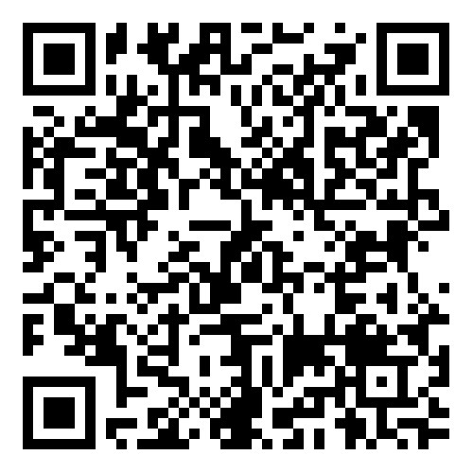
Resources
ED’s STEM Website
www.ed.gov/stem
ED’s Grants
Apply for a Grant

Slide 17
ED Initiatives
Raise the Bar
You Belong in STEM
National STEM Festival
Engage Every Student
Federal STEM Strategic Plan

Slide 18
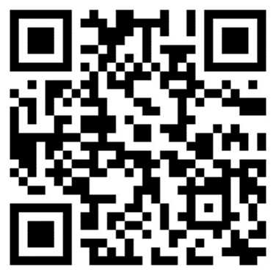
Raise the Bar

Slide 19
Raise the Bar: Lead the World

Slide 20
Raise the Bar: Lead the World

Slide 21
Raise the Bar: Lead the World

Slide 22
Ensure all students from PreK to higher education excel in rigorous, relevant, and joyful STEM learning.
Develop and support our STEM educators to join, grow, and stay in the STEM field.
Invest in STEM education strategically and sufficiently using ARP and other federal, state, and local funds.

Slide 23
Organizational Commitments
Equity & Belonging
Measurable Impact
Outcome-Oriented
Force Multiplier
Transparent
Time-Bound

Slide 24
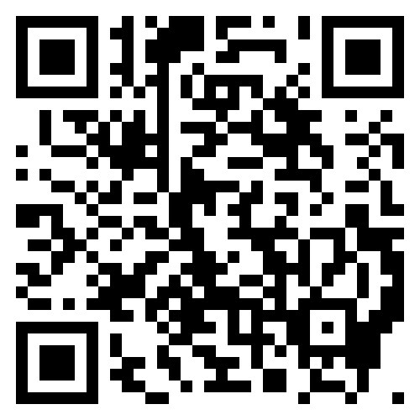
National STEM Festival
April 12-13, 2024

Slide 25
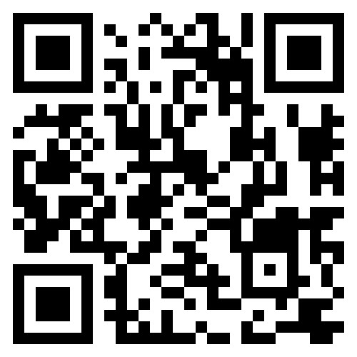

Slide 26
Any EES Partners in the Room?

Slide 27
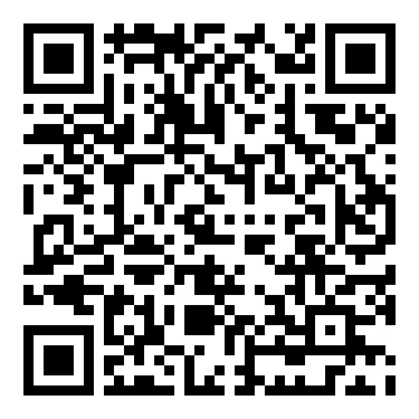
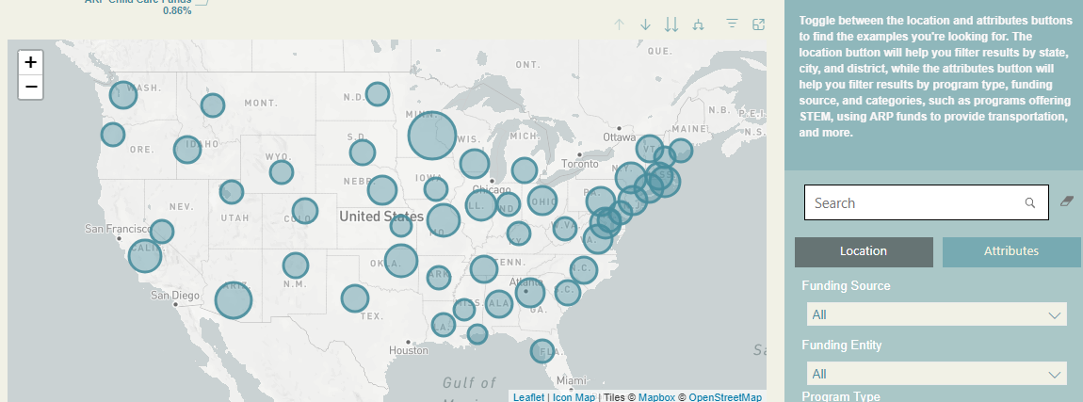
Engage Every Student
Afterschool and Summer Learning Investments

Slide 28
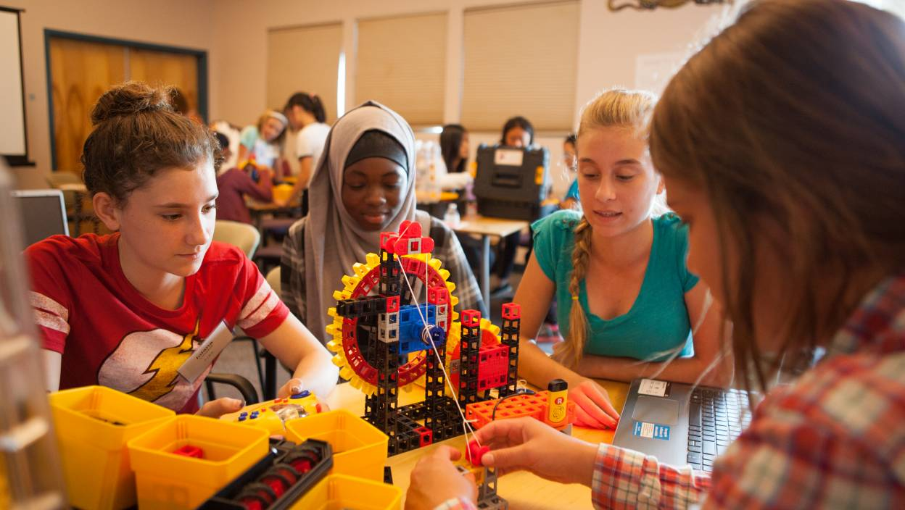
What’s Significant about OST
Collective priority on re-engaging students with learning
Urgency to accelerate learning AND support positive social interactions
Community partners are eager to partner with schools
Evidence-based models and practices exist
Unprecedented funding resources

Slide 29
OST STEM Benefits
Many summer STEM programs give students the opportunity to work alongside scientists (power of role models)
Experience hands-on STEM learning in extended time, low pressure environment
Explore STEM career options

Slide 30
OST Research
Research shows that high-quality, expanded STEM learning opportunities can improve academic outcomes, increase college and career readiness, and foster positive youth development
While the pandemic negatively impacted learning in STEM subjects, increasing investments in quality afterschool STEM programs will help re-engage youth by offering all learners
opportunities to build perseverance and agency,
by stimulating career interests through fostering a sense of identity and belonging in STEM,
by building STEM-specific knowledge and skills,
by providing joyful learning experiences that demonstrate the relevance and applicability of STEM in daily life.

Slide 31
YOUR Action Items
Seize the Moment
Using & Building Evidence
Share Your STEM Stories
Connect & Engage

Slide 32
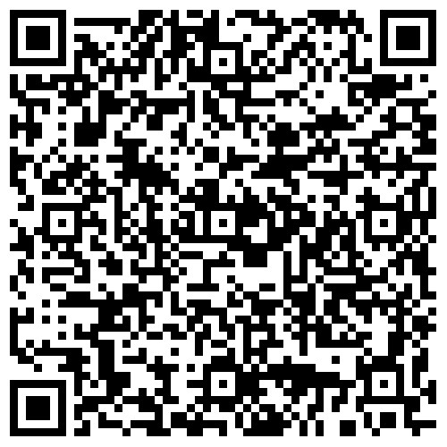
Seize the Moment
Afterschool and Summer Learning: An Unprecedented Opportunity to Engage Students in STEM - STEM Next

Slide 33
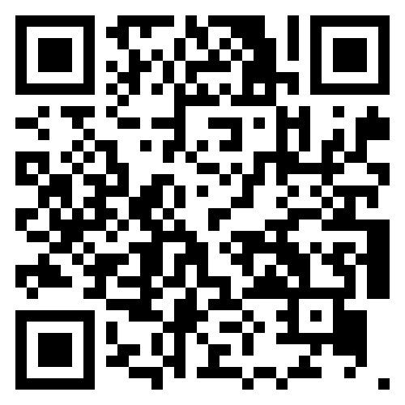
Best Practices Clearinghouse
Share your STEM Stories
We invite you as well to submit your best practices related to the Raise the Bar pillars and visit the Best Practices Clearinghouse to find current resources and information on how other States and districts are Raising the Bar to advance educational equity and excellence for all students.

Slide 34
Using & Building Evidence

Slide 35
Connect & Engage
Connect with organizations like the STEM Connector, Afterschool Alliance, STEM Education Coalition
Sign up as a supporter of Federal initiatives like Engage Every Student, National Partnership for Student Success, YOU Belong in STEM, STEM Opportunity Alliance and YouthEmploymentWorks
Engage with Federal agencies on social media

Slide 36
Contact Information
Holly Miller
hmiller@stemnext.org
Patti Curtis
Patti.Curtis@ed.gov

